Slide 1
Interesting case
R1สุพฤกษ์ / อ.ธีรวัฒน์

Slide 2
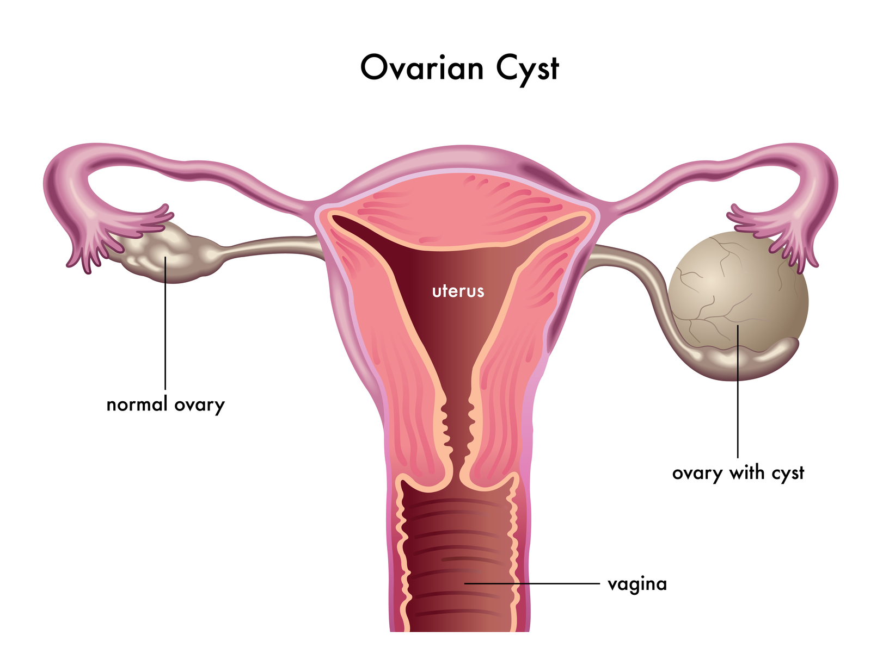
Case
ผู้ป่วยหญิง อายุ 39ปี
Dx : G1P0 GA14wk with Lt. ovarian cyst
Op : Laparoscopic Lt. salpingo-oophorectomy

Slide 3
History
CC : พบถุงน้ำที่รังไข่ซ้าย 2wk PTA
PI :2wk ฝากครรภ์ครั้งแรก ตรวจพบก้อนที่ท้องน้อยด้านซ้าย ไม่ปวดท้อง ไม่มีเลือดออกทางช่องคลอด ขับถ่ายได้ปกติ ตรวจU/Sพบถุงน้ำที่รังไข่ซ้าย จึงนัดมาผ่าตัด

Slide 4
R1 History

Slide 5
History
No underlying disease
No current medication
No drug and food allergy
No alcohol drinking
No smoking

Slide 6
History
No previous surgery
Functional class I
1st ANC GA 12 wk

Slide 7
R1 Physical examination

Slide 8
Physical examination
Vital signs
BP 122/82 mmHg HR 70 bpm
BT 37 c RR 16 bpm
BW 51 kgs Ht 162 cms BMI 19.4 kg/m²
GA : A Thai female, good consciousness, well co-operated
HEENT : no pale conjunctivae, no icteric sclerae

Slide 9
Physical examination
Airway :
Mallampati grade 2
Thyromental distance > 6 cm
Mouth opening > 3 cm
Upper lip bite test grade I
No prominent incisor
no limit head and neck motion

Slide 10
Physical examination
RS : clear, equal breath sound, no adventitious sound
CVS : pulse full and regular, normal s1,s2 , no murmur, capillary refill < 2 second
Abdomen : FH 1/3>PS , Mass at LLQ

Slide 11
Physical examination
Extremities : no pitting edema
Neuro : E4V5M6, motor grade 5 all, sensory intact

Slide 12
R1 Investigation

Slide 13
Investigation
CBC : Hb 12g/dl Hct36.9%,
Platelet263,000/mm3
BUN/Cr :5/ 0. 6 mg/dL

Slide 14
Investigation
TVS :
SVF
CRL 5.5cm
Lt ovary : homogeneous hypoechoic mass 9.8x8.2 cm

Slide 15
R1 Problem lists & ASA classification

Slide 16
Problem lists
G1P0 GA14wk with Lt. ovarian cyst set OR for Laparoscopic Lt. salpingo-oophorectomy
Full stomach
Difficult airway

Slide 17
ASA classification
ASA II

Slide 18
R2 Preoperative evaluation

Slide 19
Timing of surgery
Elective vs Emergency surgery
Elective surgery should not be performed during pregnancy
Urgent operation is often indicated for abdominal emergencies,malignancies , neurosurgical and cardiac conditions
Notes:
Emergency Sx Timingเหมือนคนปกติ

Slide 20
Timing of surgery
Second trimester is the optimal time to perform surgery
Lowest risk of preterm labor
First trimester should be avoided
Period of organogenesis

Slide 22
Laparoscopic surgery
Shorter hospitalization
Less postoperative pain
Faster return to normal activities : GI function, less uterine irritability, decreased fetal depression

Slide 24
Fetal monitoring
FHR and uterine activity should be monitored both before and after surgery
Continuous FHR monitoring is feasible beginning at 18-20 weeks

Slide 25
Fetal monitoring
Intraoperative FHR monitoring may be considered when technically feasible
Type and site of surgery
Gestational age
Ease of monitoring

Slide 26
Physiologic change during pregnancy
Cardiovascular system
Respiratory system
Hematologic system
Gastrointestinal system

Slide 27
Cardiovascular system
Increase in intravascular volume
Increase in cardiac output
Increase stroke volume and heart rate
Decrease peripheral vascular resistance

Slide 28
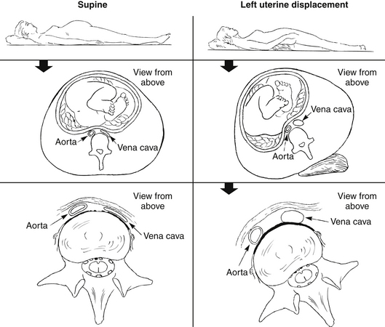
Cardiovascular system
Aortocaval compression

Slide 29
Respiratory system
Decrease FRC and increase O₂ consumption
Rapid desaturation and hypoxemia
Increase alveolar ventilation
Chronic respiratory alkalosis, decrease bicarbonate
increase mucosal vascularity
Difficult mask ventilation and intubation
Increase risk of bleeding with nasotracheal and NG tube

Slide 30
Difficult airway
Capillary engorgement and edema of the mucosal lining of oropharynx, larynx, trachea
Increase risk for bleeding during manipulation of upper airway
Increase risk of difficult ventilation and intubation

Slide 31
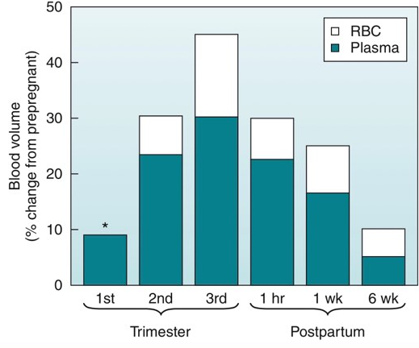
Hematologic system
Physiologic anemia of pregnancy
Increase coagulation factor
Factor I, VII, VIII, X, XII, von Willebrand
Increase risk of thromboembolism

Slide 32
Gastrointestinal system
Gastric emptying time is not altered at any time during pregnancy
LES may become distorted and incompetent by progesterone
The pregnant women are at risk for aspiration from the beginning of the second trimester onward

Slide 33
Altered response to Anesthesia
Decrease MAC for inhaled anesthetic agents
Decrease protein binding from low albumin
Increase free form of drugs
Increase sensitivity to local anesthetic
Decrease LA dose requirement
Notes:
Increase alveolar ventilation
Rapid induction of GA

Slide 34
R2 Preoperative preparation & Premedication

Slide 35
Preop preparation
Inform consent , Reassuring
NPO
Force air warmer
warm IV fluid
difficult airway equipment
G/M PRC 1U

Slide 36
Premedication
Aspiration prophylaxis
Ranitidine 50 mg iv
Plasil 10 mg iv

Slide 37
Choice of anesthesia
GA with ETT with RSI with cricoid pressure

Slide 38
Intraoperative management
Monitoring : EKG , NIBP , O₂sat , EtCO₂ , urine output
Position : Lithotomy
Notes:
ต่อไป consideration

Slide 39
R3 Anesthetic consideration

Slide 40
Uteroplacental perfusion
UBF = Uterine artery pressure - Uterine venous pressure
Uterine vascular resistance

Slide 41
Uteroplacental perfusion

Slide 42
Uteroplacental perfusion
Maternal hypotension → decrease uteroplacental perfusion & cause fetal asphyxia
Deep level of anesthesia
Aortocaval compression
Pneumoperitoneum
Hemorrhage
Hypovolemia
Reverse Trendelenburg position
High level of spinal or epidural blockade

Slide 44
Risk of Teratogenicity
Factor influencing
Genetic factor
Dose of anesthetic agent used
Access of the agent to the fetus
Fetal developmental stage

Slide 45
Risk of Teratogenicity
Maximum sensitivity of organs for development of structural abnormalities
Brain 18 - 16 days
Heart 18 - 40 days
Eyes 24 – 40 days
Limbs 24 – 36 days
Gonads 37 – 50 days

Slide 46
Risk of Teratogenicity

Slide 47
Risk of Teratogenicity

Slide 48
Nitrous oxide
Methionine synthase Inhibition
Decrease Tetrahydrofolate(THF)
Decrease DNA synthesis

Slide 49
Nitrous oxide

Slide 50
Nitrous oxide
Reproductive effects occur only after prolonged exposure to high concentration that are unlikely to be encountered in clinical anesthesia

Slide 51
Benzodiazepine
No evidence suggests that a single dose of benzodiazepine during anesthesia would prove harmful to the fetus

Slide 52
Laparoscopy
Effects of laparoscopy on fetal well being
Uterine or fetal trauma
Fetal acidosis from absorbed carbon dioxide
Decreased maternal cardiac output and uteroplacental perfusion
Notes:
Decreased maternal cardiac output and uteroplacental perfusion resulting from an iatrogenic increase in intraabdominal pressure

Slide 53
Laparoscopy
No difference in maternal and fetal outcomes between laparoscopy and laparotomy
Surgeon should be experienced with the technique
Anesthesiologist must be aware of the accompanying cardiorespiratory changes

Slide 54
Laparoscopy
Uteroplacental perfusion decreased by 61% from CO₂ pneumoperitoneum at a pressure of 20 mmHg
It is unclear whether the severity of acidosis and decrement in uteroplacental perfusion are related to insufflation pressure
Notes:
Uteroplacental perfusion decreased by 61% from CO₂ pneumoperitoneum at a pressure of 20 mmHg

Slide 55
Laparoscopy
The pneumoperitoneum resulted in increased peak airway pressure and decreased total lung compliance, changes that were progressively greater with advancing gestation
Hyperventilation may reduce uteroplacental perfusion and affect fetal oxygenation
Notes:
Uteroplacental perfusion decreased by 61% from CO₂ pneumoperitoneum at a pressure of 20 mmHg

Slide 56
Start Anes 9.00
BP 124/68 mmHg
PR76 bpm

Slide 57
Induction & intubation:
Fentanyl 50 mcg
Propofol 150mg
SCH 100 mg
LV gradeIV by Macintosh→LV gradeI by Glidescope
ETT no 7.0 depth 20 cm

Slide 58
Maintainance: Air:O₂:0.5:0.5 Desflurane6%
Muscle relaxant: Cisatracurium 13mg
Analgesia : Fentanyl 125 mcg
Reverse : Neostigmine 2.5 mg +Atropine 1.2mg
Antiemitic : onsia 8 mg IV IV fluid : Acetar 800 ml
Urine output : 250 ml
EBL : 50ml
Operation time : 2 Hr 20 min

Slide 59
Post-operative
S : ตื่นดี หายใจปกติ ไม่ปวดแผล ไม่มีเลือดออกทางช่องคลอด
O : BP 132/70 mmHg PR 93 BPM BT 37.4°C RR 16 breaths /min
FHR 130 bpm
A + P
S/P Laparoscopic Lt. salpingo-oophorectomy
Pain control : Paracetamol(500) 1 tab po prn q 4-6hr

